Slide 1
Access Control
Sessions

Slide 2
Access Control with Session Management
With session management techniques you can use password log in to control page access.
Process
  Create a database with username/password pairs
  Provide a form for login. Compare submitted form data against database
  If valid, set a $_SESSION variable to indicate successful login
  Call session_start() and check relevant $_SESSION variable before displaying restricted pages
This code can all be placed in a single include file which is then included at the start of each restricted page.

Slide 3
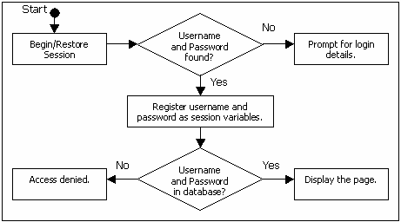
Access Control
Flow chart (from K. Yank, Build Your Own Data-base-Driven Website)
Notes:
This can all be implemented as a single self-referential php fle.
The branching is handled via an if construct. The database via mysql.
If access is denied, we will use the “exit” command to stop processing entirely. That way, we can put this code at the front of any secure page. If there is a problem, the secure code will not be reached.

Slide 4
Access Control
Pseudocode
Call session_start();
Check $_POST for userName and userPassword (user came from the login form)
Check $_SESSION for userName and userPassword (user has already logged in)
If no value found for userName and userPassword
{
show login form (action is self, so submit will rerun this code)
exit; (exits from this file and from any file which includes this file)
}
//If we got this far, there are values for userName and userPassword.
Query the user/password database to make sure this login is valid
If not, give feedback and exit
// if we got this far, the userName and userPassword are valid
Store userName and userPassword values in $__SESSION
Notes:
The checking can be done with and if isset on one and a default to the other. Then just look to see if the variable got set
Note that in the actual code from the book (for those of you who have it) Yank actually stores the values before checking. He does this to simplify unregistering them for repeated log in attempts, because in his version, you have a link to try to log in again.
If you go that route, this logic may appeal to you as well. Otherwise just keep track of whether they’ve been registered or not.

Slide 5
Programming Technique
Can be written as:
if (isset($_POST['userName']))
$userName = strip_tags($_POST['userName']);
else if (isset($_SESSION['userName']))
$userName = $_SESSION['userName'];
if (isset($_POST['userPassword']))
$userPassword = strip_tags($_POST['userPassword']);
else if (isset($_SESSION['userPassword']))
$userPassword = $_SESSION['userPassword'];
//do we know the username?
if(!isset($userName)) ………show login form and exit
else……… check if password user combo are in table exit on fail
Check $_POST for userName and userPassword (user came from the login form)
Check $_SESSION for userName and userPassword (user has already logged in)
If no value found for userName and userPassword
Notes:
The checking can be done with and if isset on one and a default to the other. Then just look to see if the variable got set
Think about this for awhile until you see why it works….
A tidy little pattern using your knowledge of the data.
If you’re really going for compactness, you can use the ternary if (done this way in the book)
Don’t have to do it this way if you don’t like it.
You would, of course, comment to explain your logic

Slide 6
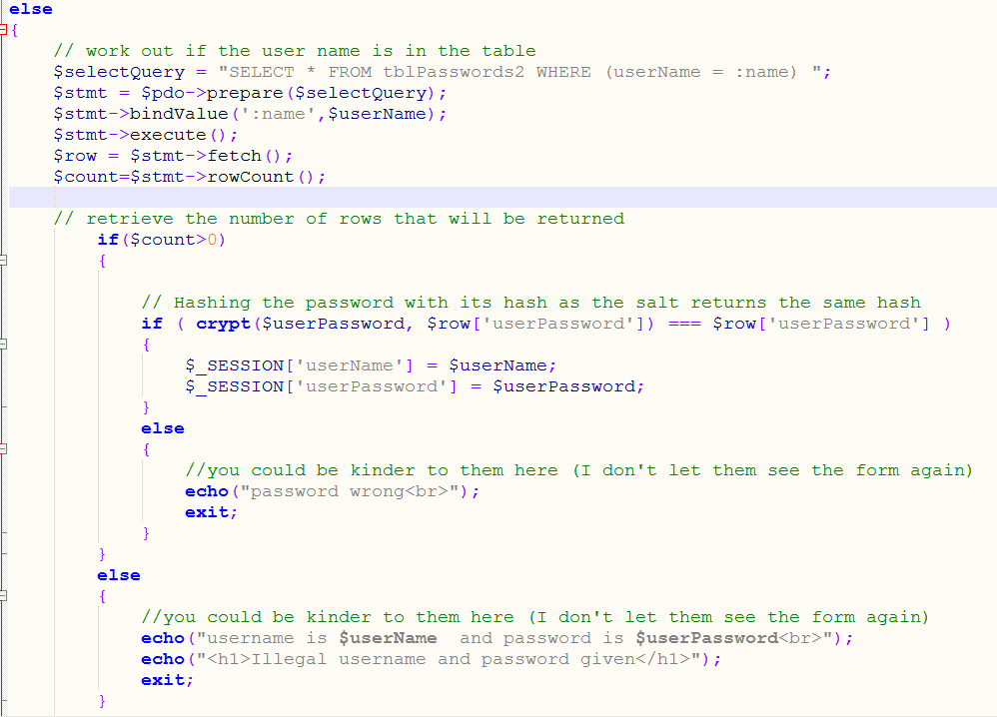

Slide 7
Practical – Logins Part 1
Create a simple user/password database on kate
Implement accessControl.php
Using accessControl.php as an include file, create a home page which:
  Requires a log in
  Shows “Congratulations username! You are allowed to be here.”, upon successful log in
Notes:
Give out handout
Where username is replaced with their username, of course….

Slide 8
Practical – Part 1
Hint 1: Think about what the user will see if he gives an incorrect login.
Hint 2: My home page file for step 3 contains only two php statements (and one of them is the include…)

Slide 9
Practical – Part 2
Extend your page from step 3 above to include a link for logging out.
Build a secure logout page
  If a user is already logged in, he isn’t prompted again
  If he is not logged in, he will be asked for username and password
Test to insure that, having logged out, the user can no longer access your home page without being required to log in again.

